Slide 1
What You
Need to Know
About Financial Aid

Slide 2
Topics We Will Discuss
What is financial aid?
Cost of attendance (COA)
Student aid index (SAI)
Financial need
Categories, types, and sources of financial aid
Free Application for Federal Student Aid (FAFSA®)
Special and unusual circumstances

Slide 3



What Is Cost of Attendance (COA)?
Tuition and fees – Direct Cost
Housing and food – Indirect Cost
Books and supplies – Direct Cost
Transportation – Indirect Cost
Miscellaneous and personal – Indirect Cost

Slide 4
What Is Student Aid Index (SAI)?
Number resulting from the evaluation of a student’s (and family’s) approximate financial resources for a student’s postsecondary education
Student contribution
Parent contribution
(for dependent students)

Slide 5
What Is Financial Need?
Cost of attendance (COA) – Student aid index (SAI) = Financial need

Slide 6
Types of Financial Aid
Scholarships
Grants
Loans
Work-Study Employment
Yadkin Guarantee
Self-Help Aid
Gift Aid

Slide 7
Free Application for Federal Student Aid (FAFSA®)
May be filed at any time during an academic year, but typically no earlier than October 1st prior to the academic year for which the student requests aid
For the 2024-25 academic year, the FAFSA may be filed starting in December 2023 (exact date to be determined)
Colleges may set FAFSA priority dates

Slide 8
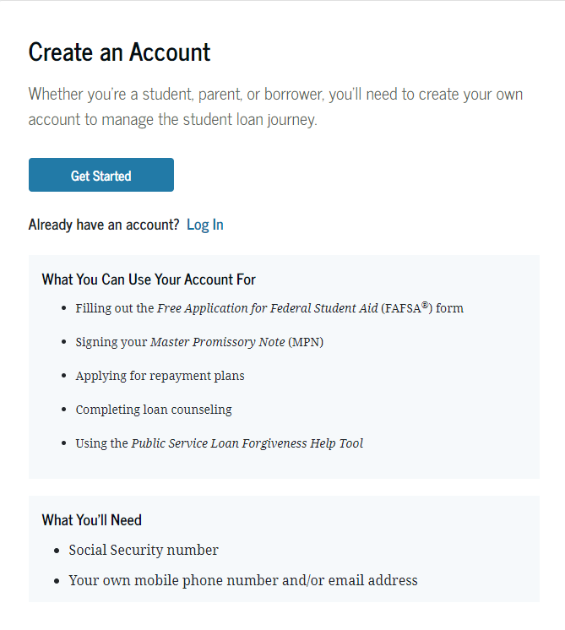
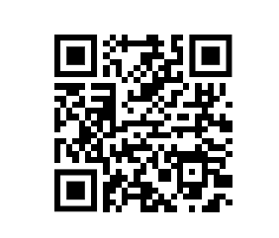
Account Username and Password (FSA ID)
Used for FAFSA completion
and access to certain U.S. Department of Education websites
Student and parent must
create own FSA ID
May be used throughout
financial aid process,
including subsequent
school years
Only the owner should
create an FSA ID
Create your FSA ID TODAY
Apply at https://studentaid.gov/fsa-id/create-account/launch

Slide 9
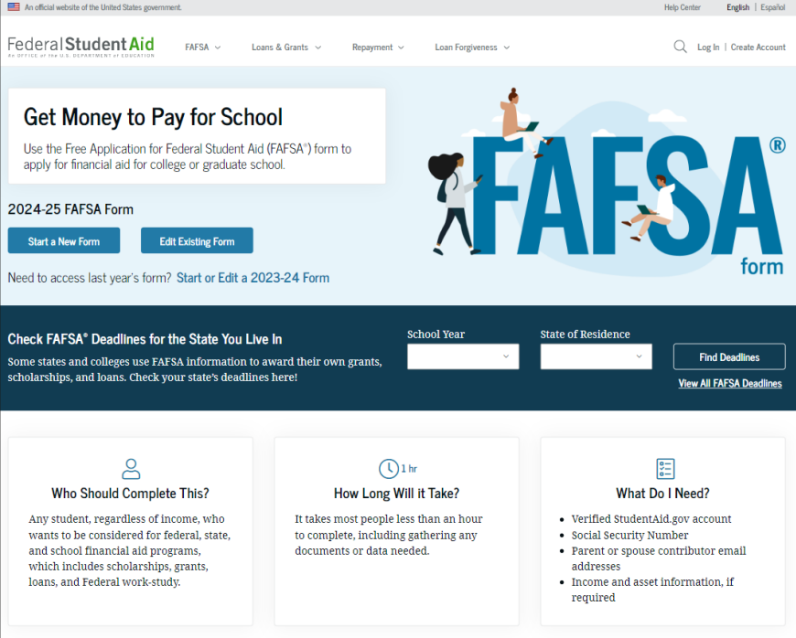
Online FAFSA
Note: Online FAFSA screenshots from U.S. Department of Education’s 2024-25 FAFSA Form Preview Presentation, July 2023

Slide 10
Student Information
Identity and contact information
Consent for FTI transfer from IRS
  2022 Federal Tax Return
Marital status
College plans
Personal and unusual circumstances

Slide 11
FUTURE Act Direct Data Exchange (FA-DDX)
Allows for an individual’s federal tax information (FTI) to be directly transferred from the IRS to the FAFSA
Consent is required by all contributors on FAFSA
IRS transfers information to populate FAFSA income questions for most tax filers
Eliminates manual entry of tax and income information

Slide 12
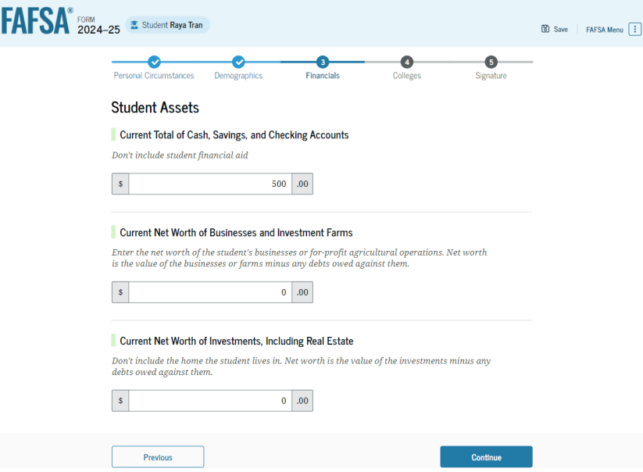
Student Financial Information
Tax return information
  Minimal questions if FTI transferred from IRS
Asset information

Slide 13
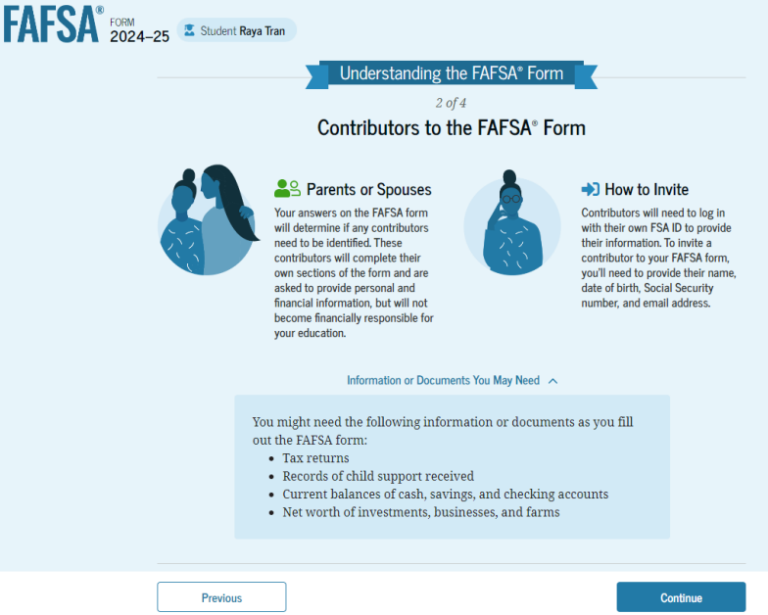
FAFSA Contributors

Slide 14
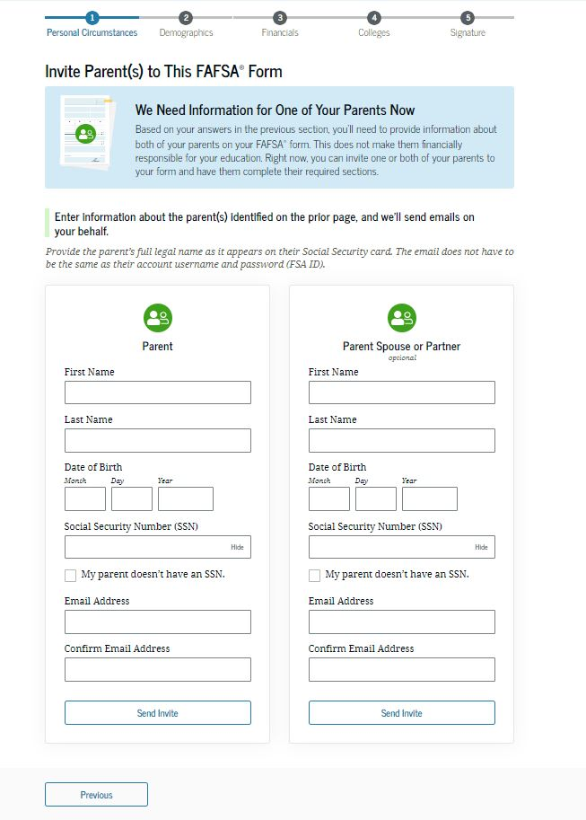
Invite parent(s) to fasfa form
Please provide the following information about student parent(s)
Legal first and last name
Date of Birth
Social Security Number (if your parent does not have a SSN, check the box below this entry field)
Email address

Slide 15
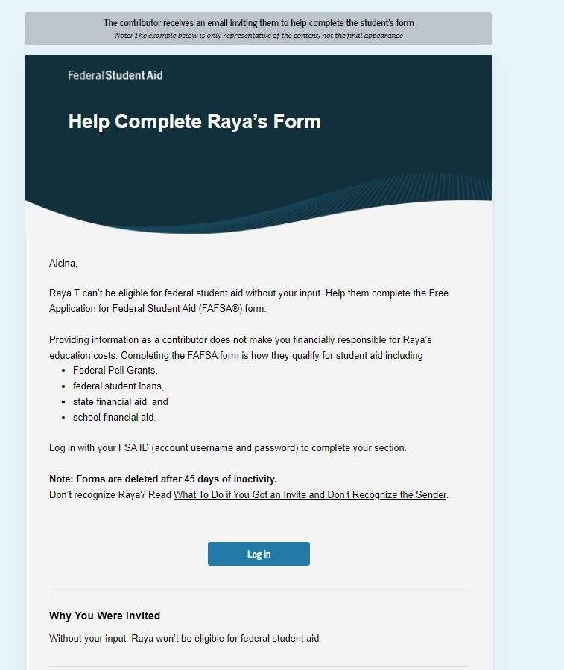
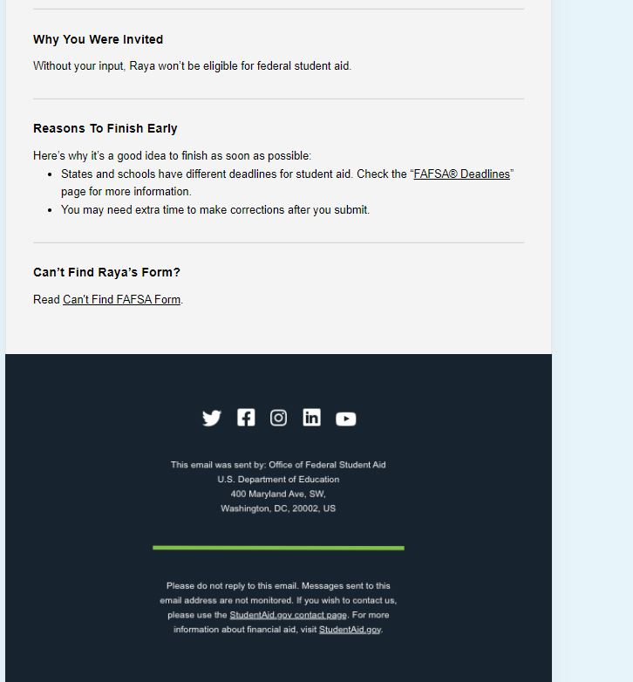
Email invitation template
Notes:
Parents should have received an email looking similar to this. Please proceed to click on the “log on” button.

Slide 16
Parent Information
Identity and contact information
Consent for FTI transfer from IRS
  2022 Federal Tax return
Marital status
State of legal residence

Slide 17
FUTURE Act Direct Data Exchange (FA-DDX)
Allows for an individual’s federal tax information (FTI) to be directly transferred from the IRS to the FAFSA
Consent is required by all contributors on FAFSA
IRS transfers information to populate FAFSA income questions for most tax filers
Eliminates manual entry of tax and income information

Slide 18
Parent Financial Information
Receipt of means-tested federal benefits in the previous two years
Tax filing status
Family size and number in college
Tax return information
  Minimal questions if FTI transferred from IRS
Assets
Other parent information

Slide 19
Unusual Circumstances
Conditions that justify an institution making an adjustment to a student’s dependency status
Student does not provide parental data on FAFSA
    Considered provisionally independent
Student follows institution’s process for dependency override determination

Slide 20
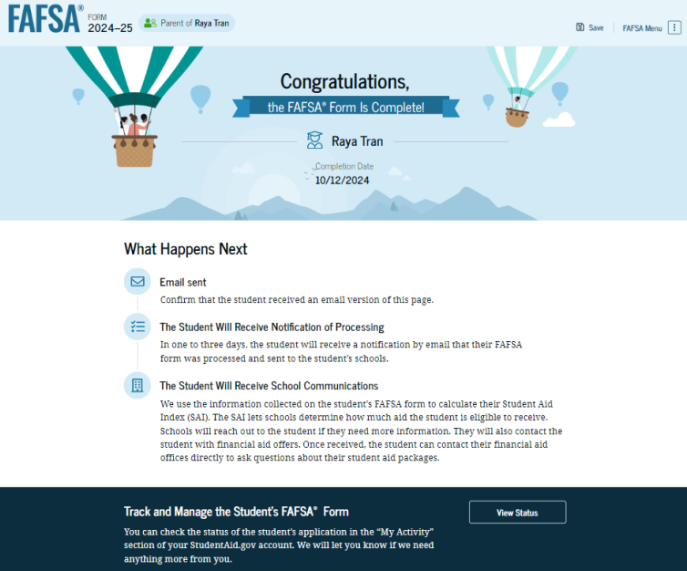
Parent Section Completion
Review of information
Signature and submission of FAFSA

Slide 21
Who Is Included in Family Size?
Dependent Filers
Student
Independent Filers
Parent (and spouse)
Parent’s dependent children, even if they live apart from the parent because of college enrollment*
Other people if they live with the parent*
Student (and spouse)
Student’s dependent children, even if they live apart from the student because of college enrollment*
Other people if they live with the student*
* Included only if providing more than half of their support between July 1, 2024 and June 30, 2025

Slide 22
College may request additional or supporting documentation
DOE selects every third FAFSA that is processed
Please submit requested documentation to college’s financial aid office in a timely manner to avoid awarding delays
  Identity
  Taxes/W2s
  Martial status
  Household
  other

Slide 23

Special Circumstances
Unusual uncovered medical/dental expenses
Secondary school tuition
Extraordinary dependent care
Parent or spouse death
Additional family members in college
Loss of employment or income
Divorce

Slide 24
Questions?
Contact Info
Heather Couch
Financial Aid Compliance Specialist
(336) 386-3462
couchhn@surry.edu
Jodie Gammons
Financial Aid Specialist
(336) 386-3458
gammonsjl@surry.edu
Jay McDougal
Veterans Affairs and Financial Aid Specialist
(336) 386-3245
mcdougaljr@surry.edu
Elizabeth White
Director of Financial Aid and Veterans Affairs
(336) 386-3356
whiteeh@surry.edu
Thank You!

